Slide 1
Web Science:
Visualizing Social Networks
(Part 1 - Graph Drawing and Layouts)
CS 432/532
Old Dominion University
Permission has been granted to use these slides from Frank McCown, Michael L. Nelson, Alexander Nwala, Michele C. Weigle
This work is licensed under a Creative Commons Attribution-NonCommercial-ShareAlike 3.0 Unported License

Slide 2
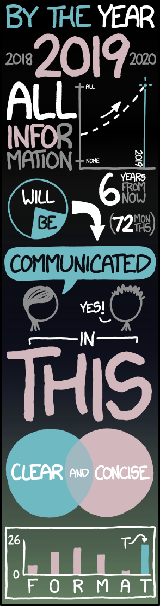
'Big Data' doesn't just mean increasing the font size
Tall Infographics (xkcd comic)

Slide 3
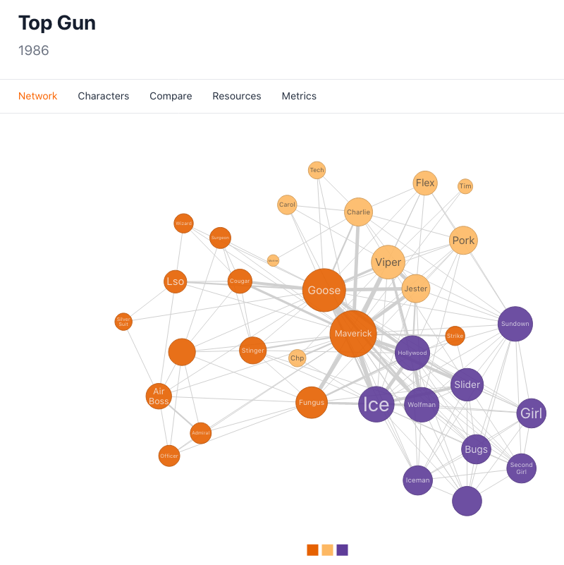
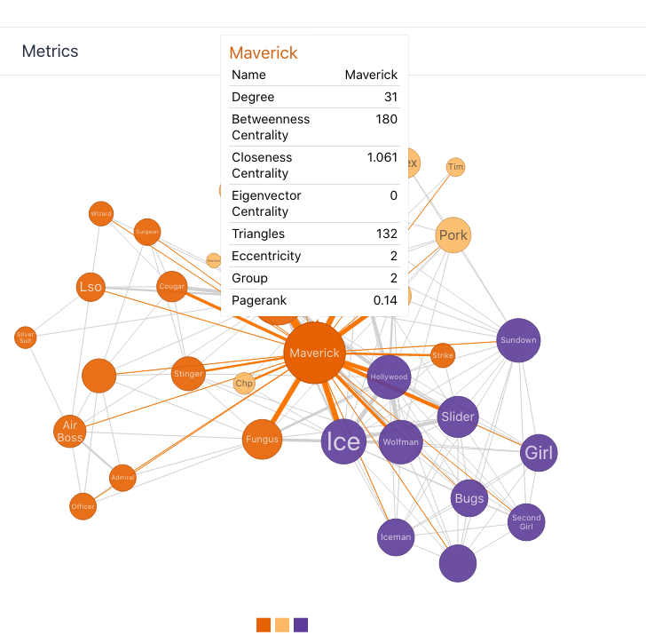
Moviegalaxies (Top Gun)

Slide 4
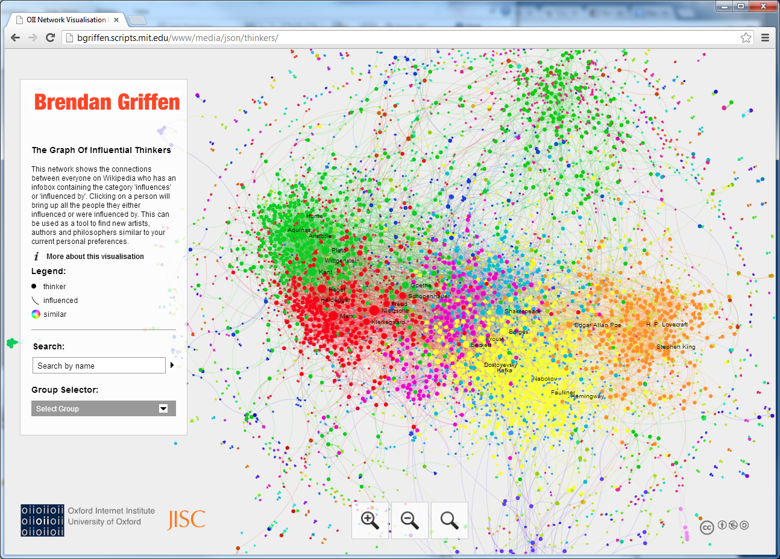
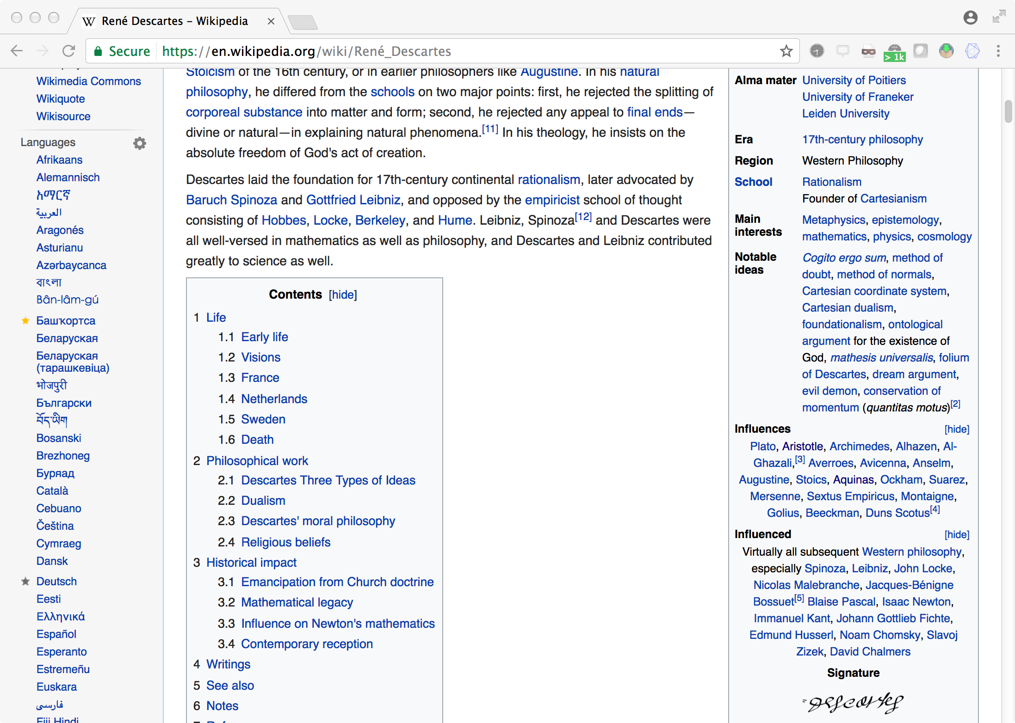
Graphs of Wikipedia: Influential Thinkers
René Descartes (Wikipedia)

Slide 5
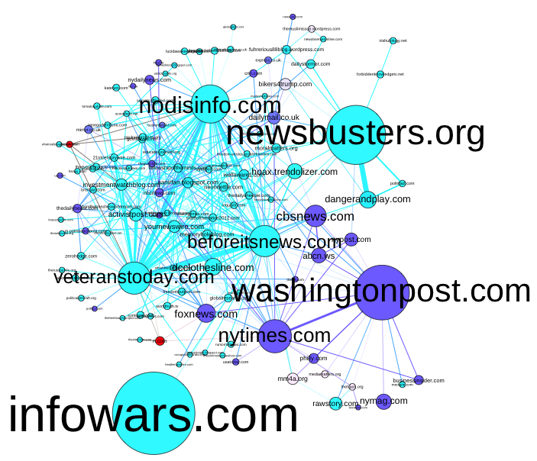
Tweets about shooting events that also contained terms such as “false flag”, “hoax”, and “crisis actor”
Node - domain
Edge - if the same Twitter account posted tweets citing the two domains (in separate tweets)
Figure 1. Domain Network Graph, Colored by Media Type
Purple = mainstream media; Aqua = alternative media; Red = government controlled media
Kate Starbird, “Information Wars: A Window into the Alternative Media Ecosystem”

Slide 6
Creating a Visualization
Obtain the data
Convert data into format appropriate for importing
Import into visualization software
Choose a layout
Tinker, tinker, tinker
Wow your friends and family

Slide 7
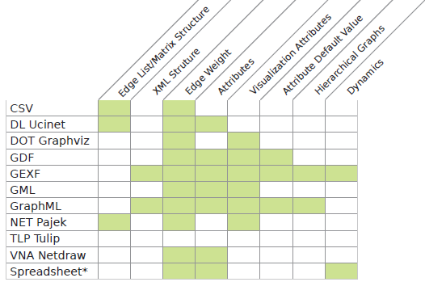
Graph Data Formats
Supported Graph Formats (gephi.org)

Slide 8
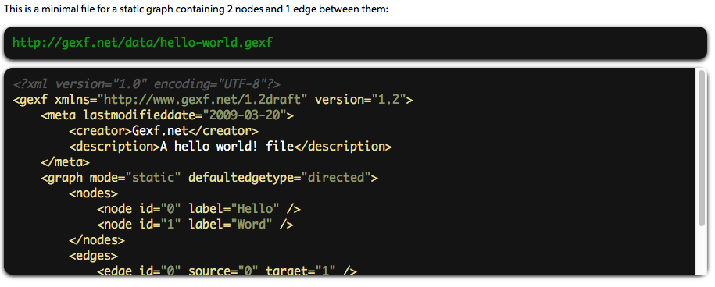
GEXF
GEXF (Graph Exchange XML Format) is a language for describing complex networks structures, their associated data and dynamics. Started in 2007 at Gephi.
GEXF File Format

Slide 9
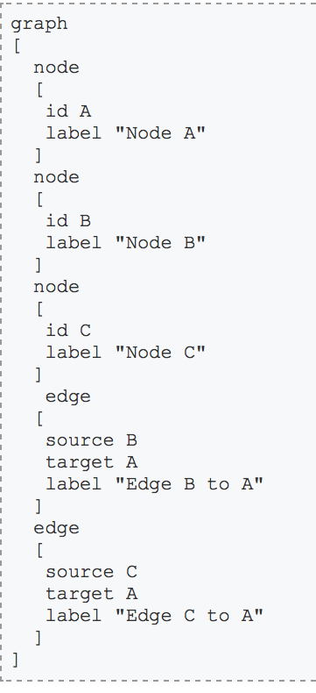
GML
GML (Graph Modeling Language) is a text file format supporting network data with a very easy syntax.
It is used by Graphlet, Pajek, yEd, LEDA and NetworkX.
GML Format

Slide 10
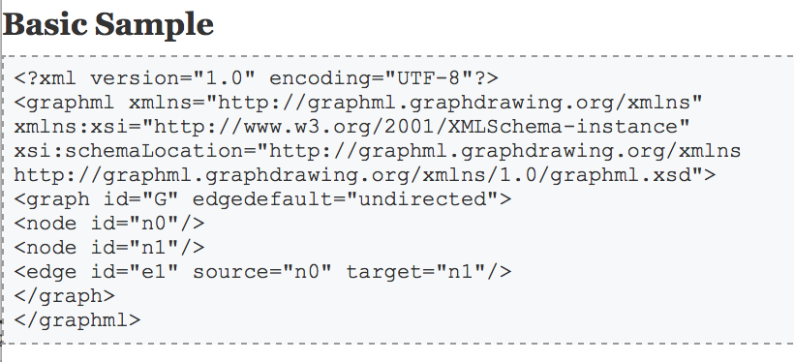
GraphML
The GraphML file format uses .graphml extension and is XML structured. It supports attributes for nodes and edges, hierarchical graphs and benefits from a flexible architecture. This format is supported by NodeXL, Sonivis, GUESS and NetworkX.
GraphML Format

Slide 11
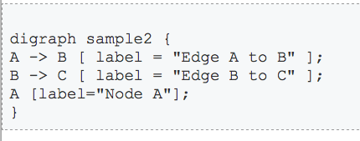
GraphViz DOT
DOT is the text file format of the suite GraphViz. It has a human-readable syntax that describes network data, including subgraphs and elements appearances (i.e. color, width, label). NetworkX, Tulip or ZGRViewer can import DOT files as well.
GraphViz DOT Format

Slide 12
JSON
{ nodes: [
{ name: "Adam" },
{ name: "Bob" },
{ name: "Carrie" },
{ name: "Donovan" },
{ name: "Edward" },
{ name: "Felicity" },
{ name: "George" },
{ name: "Hannah" },
{ name: "Iris" },
{ name: "Jerry" }
],
links: [
{ source: 0, target: 1 },
{ source: 0, target: 2 },
{ source: 0, target: 3 },
{ source: 0, target: 4 },
{ source: 1, target: 5 },
{ source: 2, target: 5 },
{ source: 2, target: 5 },
{ source: 3, target: 4 },
{ source: 5, target: 8 },
{ source: 5, target: 9 },
{ source: 6, target: 7 },
{ source: 7, target: 8 },
{ source: 8, target: 9 }
]}
JSON is the preferred file format for JavaScript-based tools, such as d3.js.
The Python library NetworkX can write out JSON.
"Data preparation with R for networks in d3.js" has R code to convert from adjacency matrix, edge list, and edge and node lists to JSON
JSON — NetworkX 2.5 documentation

Slide 13
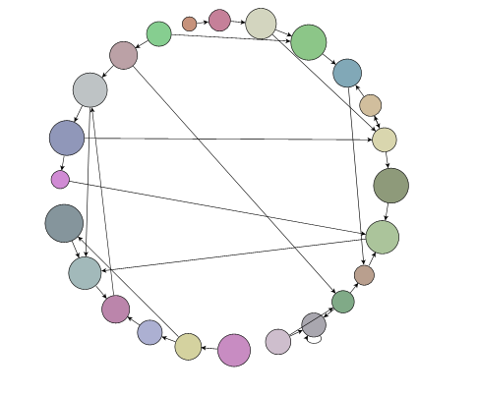
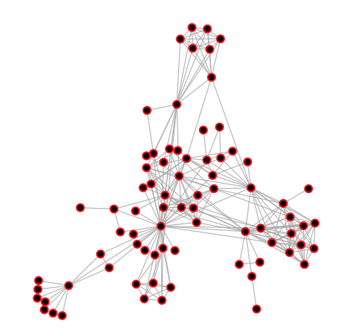
Graph Layouts
Circular - nodes are placed on a circle at even spacings
Force-directed - uses a physics simulator to emulate gravity and force which can be applied to elements
Many others...
Img source: https://www.nwoods.com/products/goxam/layout.html
Img source: https://bl.ocks.org/steveharoz/8c3e2524079a8c440df60c1ab72b5d03

Slide 14
Force-Directed Layout
Assigns forces on the nodes and edges
Spring-like forces attract connected nodes
Repulsion forces (like electrically charged particles) separate pairs of nodes
In equilibrium
edges tend to have uniform length (because of the spring forces)
nodes that are not connected by an edge tend to be drawn further apart (because of the electrical repulsion)
Gravity can be added to pull nodes toward a certain location (to prevent disconnected nodes from flying off)
Force-directed graph drawing (Wikipedia)

Slide 15
Web Science:
Visualizing Social Networks
(Part 2 - Graph Creation Software)
CS 432/532
Old Dominion University
Permission has been granted to use these slides from Frank McCown, Michael L. Nelson, Alexander Nwala, Michele C. Weigle
This work is licensed under a Creative Commons Attribution-NonCommercial-ShareAlike 3.0 Unported License

Slide 16
Graph Creation Software
Many good commercial products available
Here we only cover free, open-source software
By no means exhaustive

Slide 17
Stand-Alone Software
Gephi
Interactive visualization and exploration platform
Graphviz
Many libraries from other programming languages use it
NodeXL
Microsoft Excel template

Slide 18
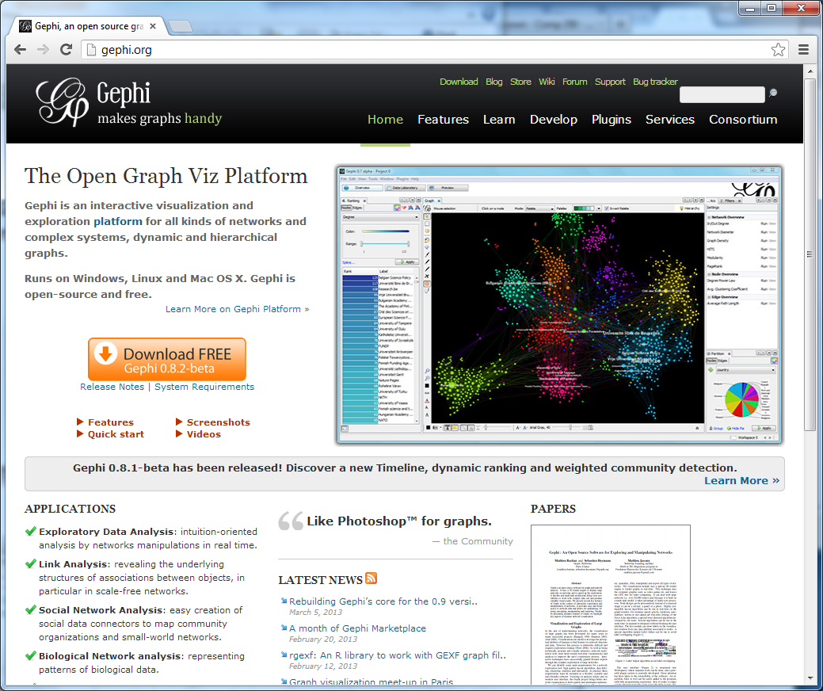
Gephi - The Open Graph Viz Platform

Slide 19
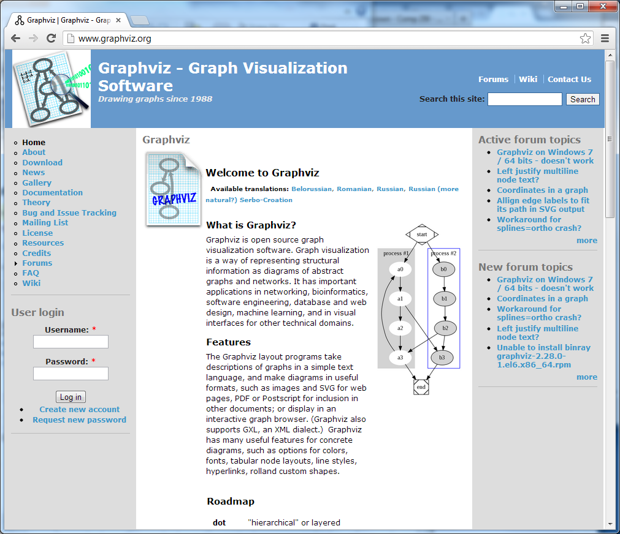
Graphviz - Graph Visualization Software

Slide 20
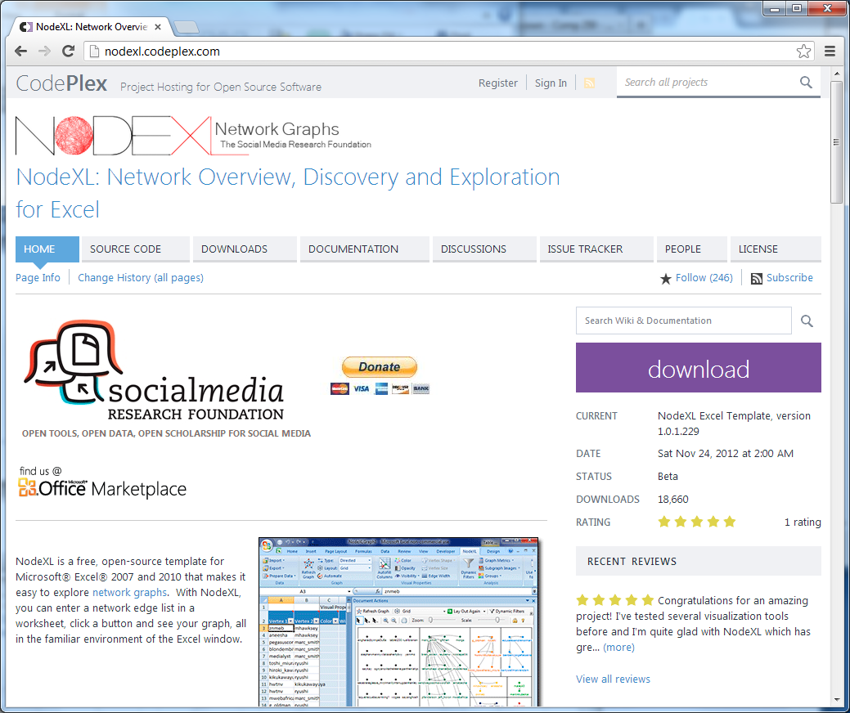
NodeXL

Slide 21
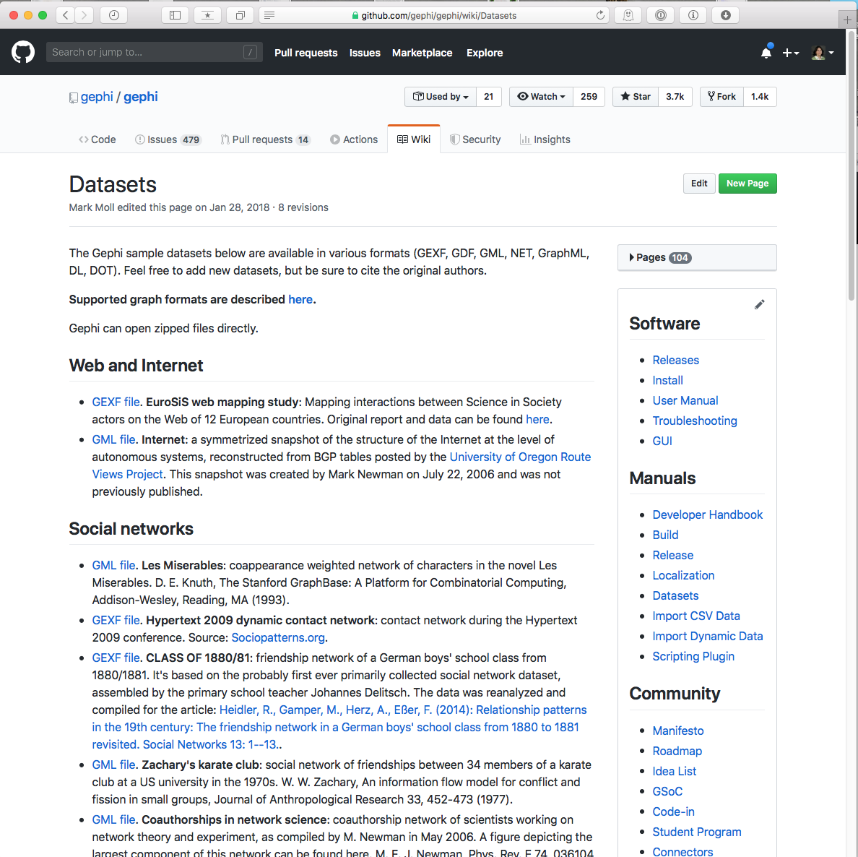
Gephi Example
Download data file from Gephi Datasets

Slide 22
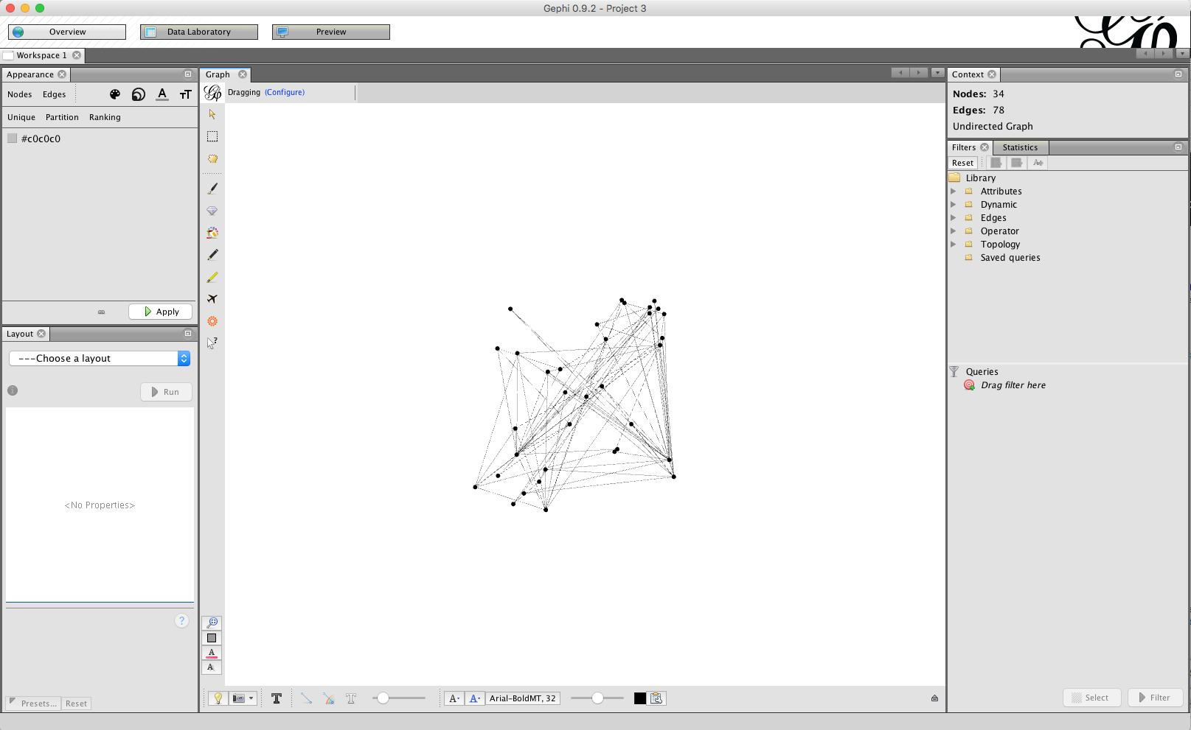
Load karate.gml

Slide 23
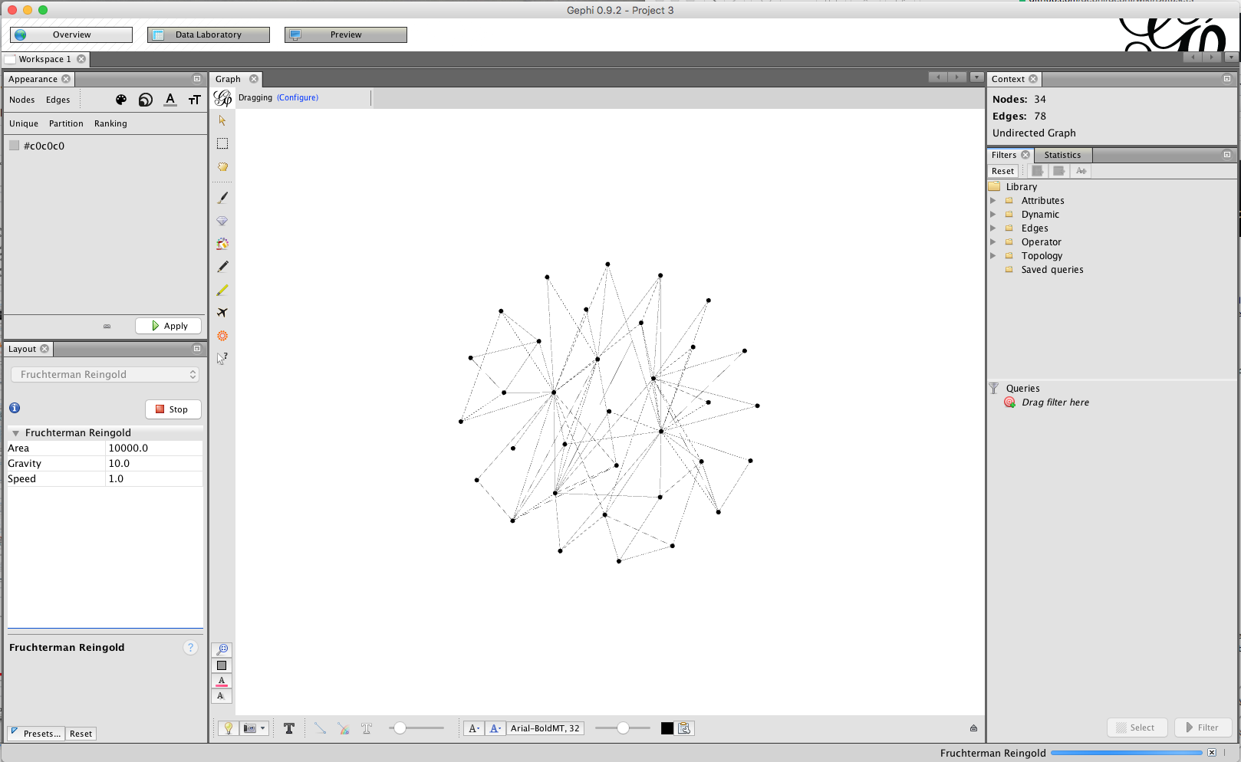
Set the layout

Slide 24
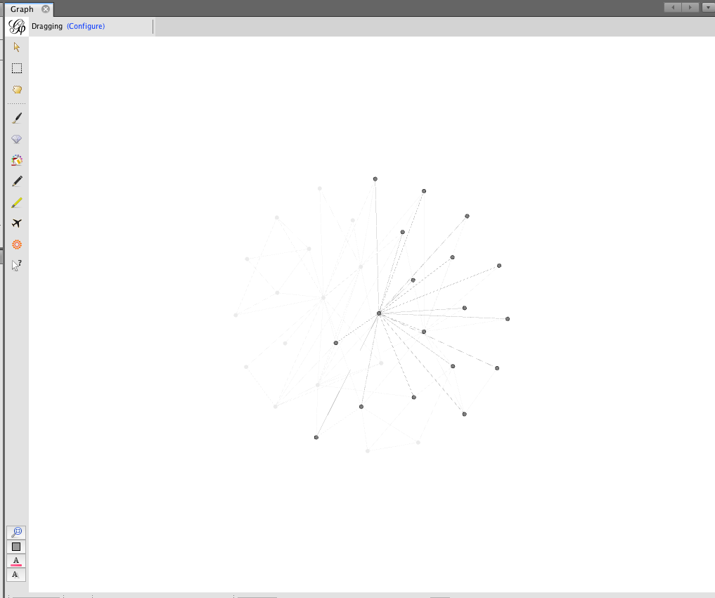
Hover to explore connections

Slide 25
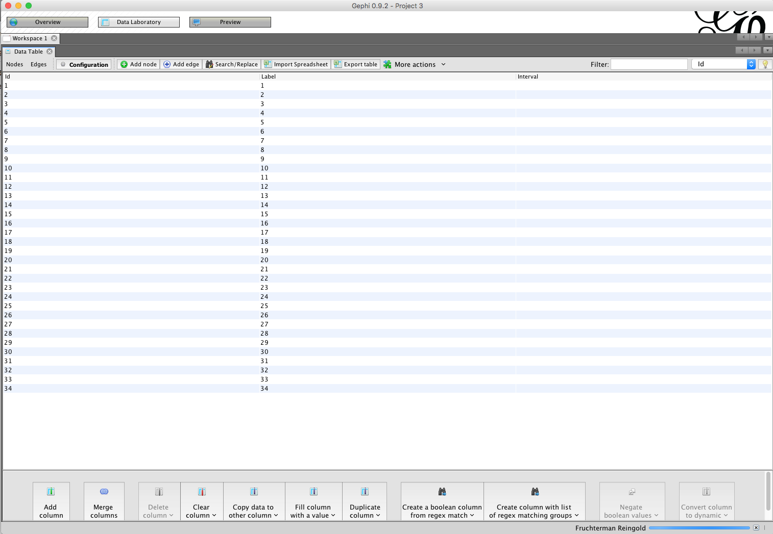
Explore the data - nodes

Slide 26
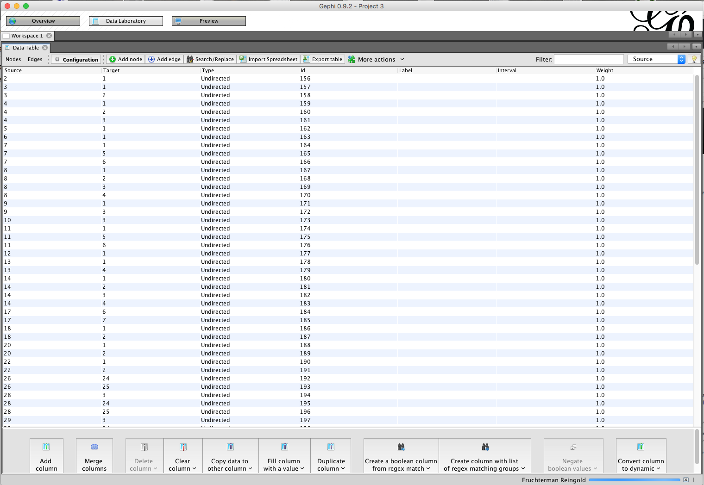
Explore the data - edges

Slide 27
Python Libraries
NetworkX – creating and manipulating graphs
uses Matplotlib or Graphviz for displaying graphs
igraph – creating, manipulating, and displaying graphs

Slide 28
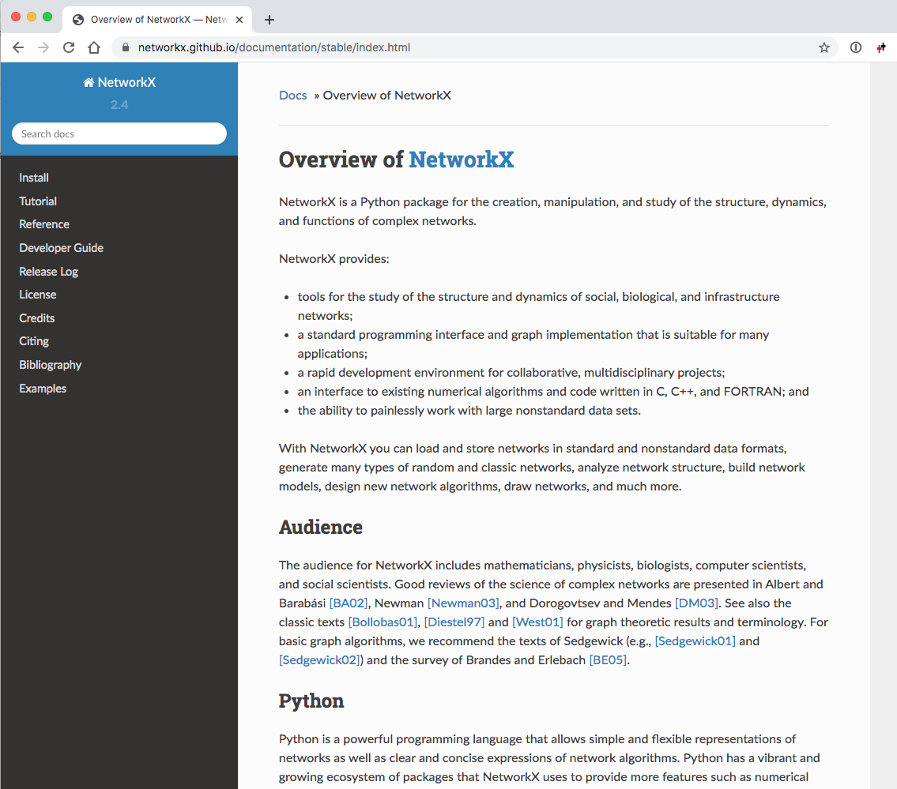
NetworkX
Tutorials, Documentation at Software for Complex Networks — NetworkX 2.5 documentation
Additional examples at NETWORK CHART

Slide 29
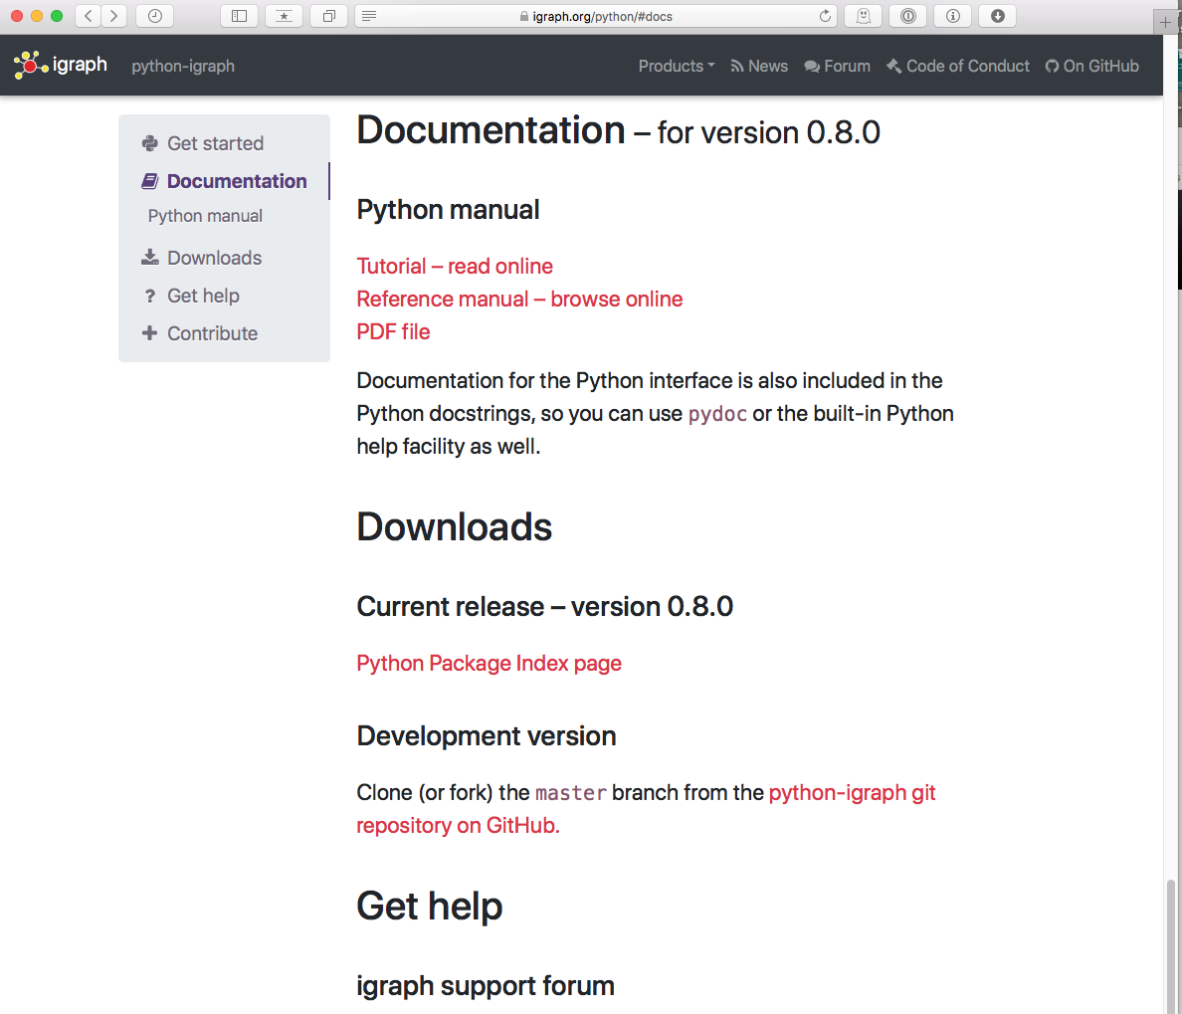
igraph-python
Tutorials, Documentation at python-igraph

Slide 30
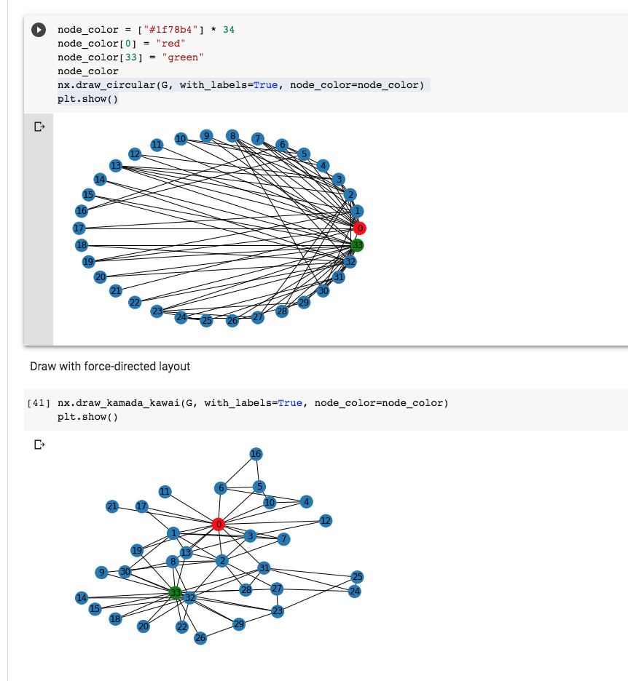
NetworkX Examples in Google Colab

Slide 31
JavaScript Graphing Libraries
D3.js
library for all types of visualization, also has higher-level APIs (Vega, Vega-Lite)
Arbor.js
library for graph visualization using jQuery, uses HTML canvas, so it won’t work in older browsers.
Cytoscape.js
library for graph theory analysis and visualization.
Sigma.js
lightweight library for graph visualization, also uses HTML canvas

Slide 32
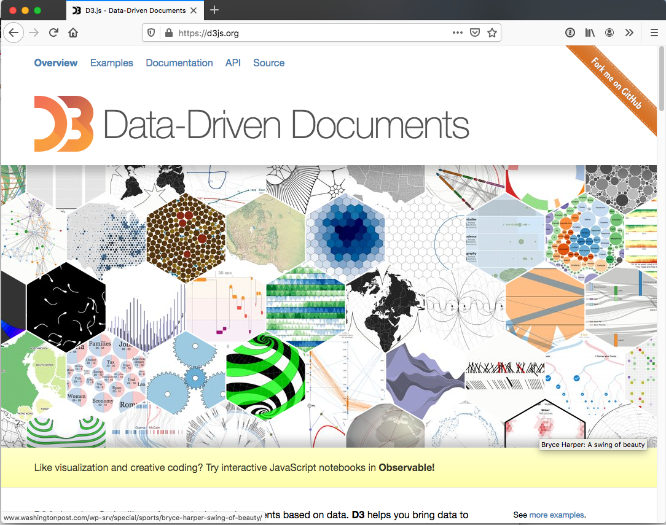
D3.js - Data-Driven Documents

Slide 33
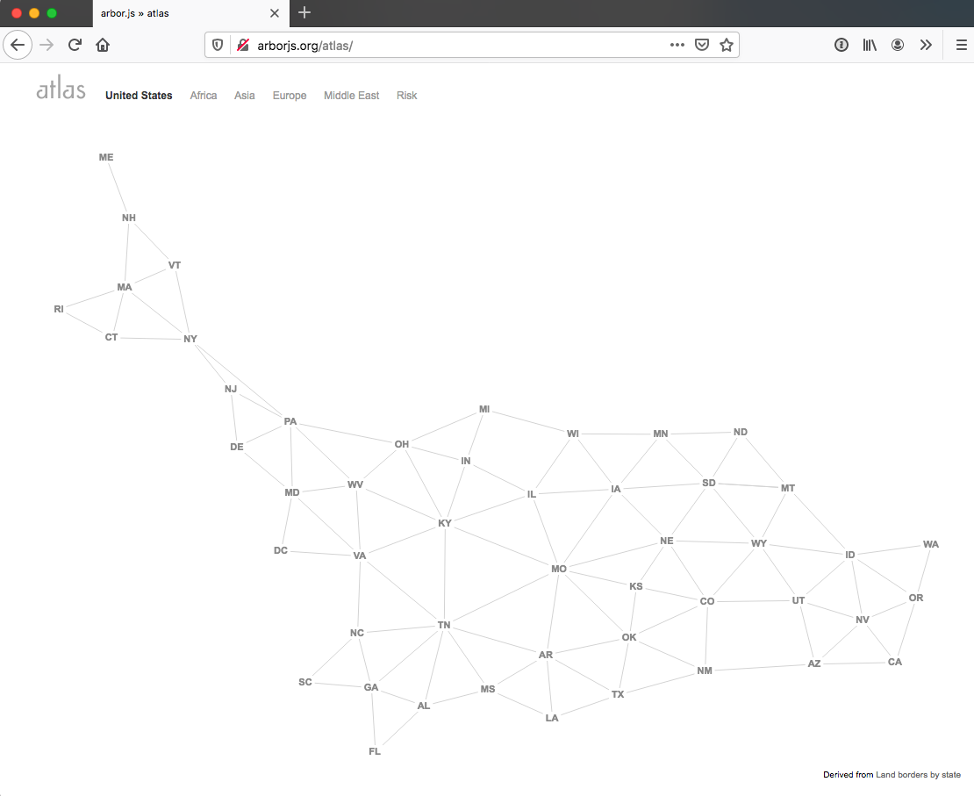
arbor.js

Slide 34
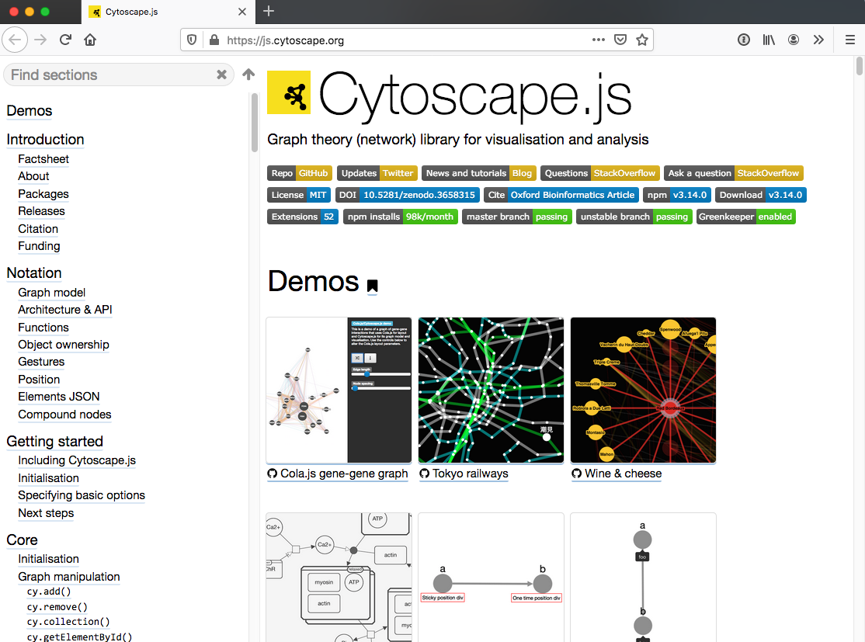
Cytoscape.js

Slide 35
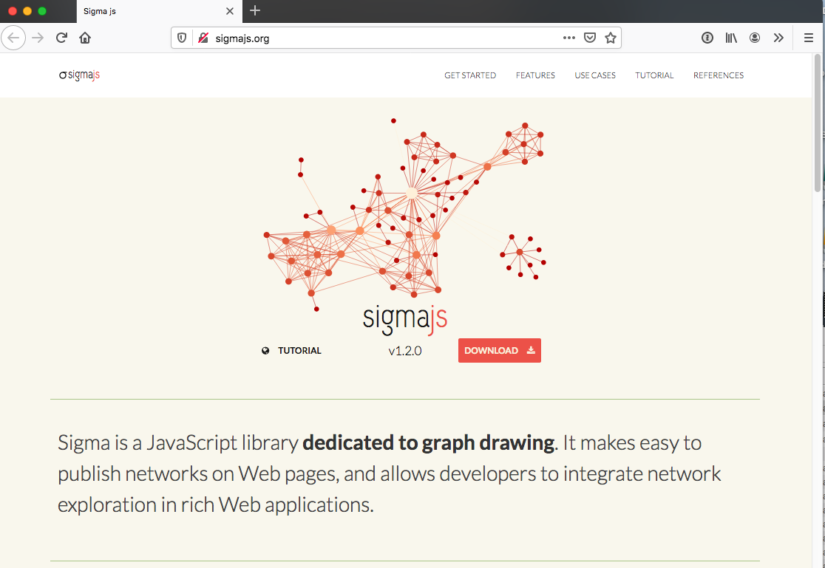
Sigma js

Slide 36
Web Science:
Visualizing Social Networks
(Part 3 - D3 Node-Link Walkthrough)
CS 432/532
Old Dominion University
Permission has been granted to use these slides from Frank McCown, Michael L. Nelson, Alexander Nwala, Michele C. Weigle
This work is licensed under a Creative Commons Attribution-NonCommercial-ShareAlike 3.0 Unported License

Slide 37
Force-Directed Layouts in D3
Centering - attracts every node to a specific position
Collision - consider nodes as circles with radius and try to avoid overlapping
Links - pushes linked nodes together, according to a link distance
Many-Body - apply general attraction (if positive) or repulsion (if negative) between nodes
Positioning - push each node towards a desired position
.force("center", d3.forceCenter())
.force('collision', d3.forceCollide())
.force("link", d3.forceLink())
.force("charge", d3.forceManyBody())
.force("x", d3.forceX())
.force("y", d3.forceY())
Network Graph | the D3 Graph Gallery
d3/d3-force: Force-directed graph layout.

Slide 38
D3 Node-Link References
Intro to Forced Layouts
Interactive & Dynamic Force-Directed Graphs with D3,
uses d3.v4 so some calls may be different than d3.v5

Slide 39
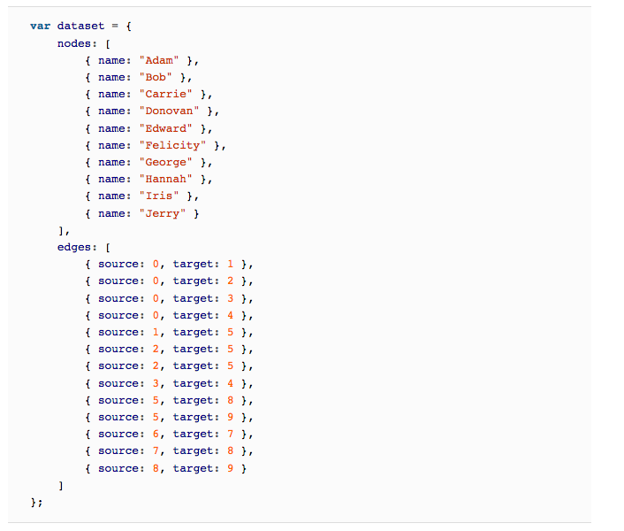
Scott Murray's Interactive Data Visualization for the Web, 2nd Ed., Ch. 13 Layouts

Slide 40
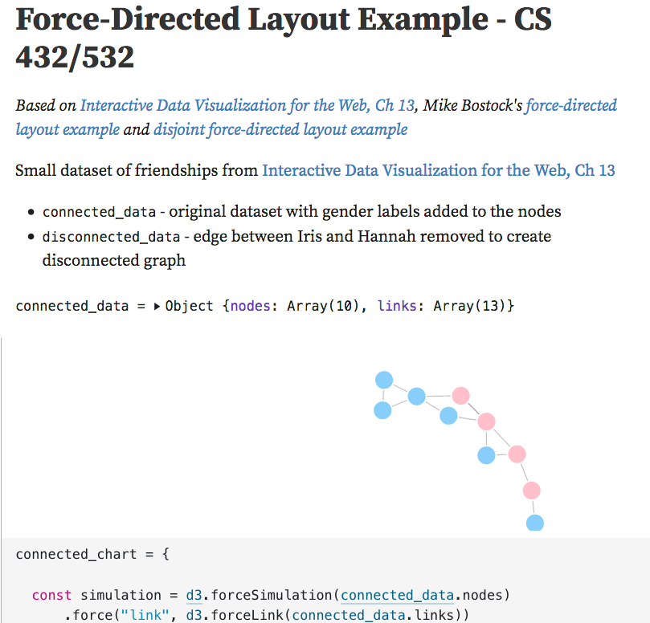

Slide 41
Further Reading on D3
D3 Intro
Mike Bostock's D3 examples
at bl.ocks.org
at observablehq.com
d3 gallery

Slide 42
Objectives
List five network data formats.
Describe a circular graph layout.
Describe a force-directed graph layout, including the effect of the forces on the edges and nodes.
Use a Python library to generate a node-link diagram of Zachary’s Karate Club.

